Slide 1
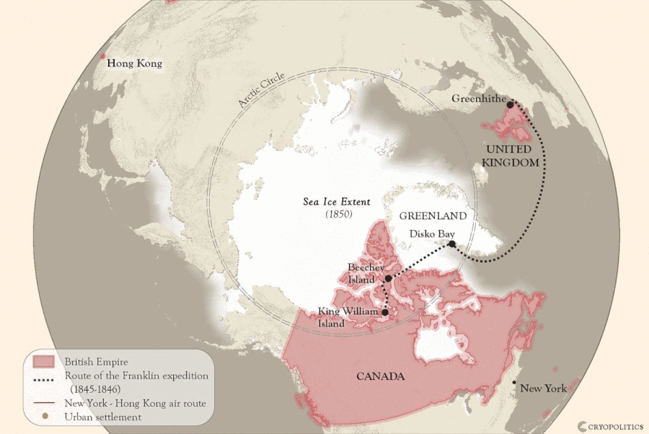
This picture shows Franklin’s expedition
route and the Hong Kong – New York
trans-Arctic air route.
If the file is downloaded, the varying
Sea Ice Extent (2018 versus 1850)
can be seen.

